Slide 1
Economic Modeling Tool for Military & Defense Contracting in Washington
January 25, 2017
Spencer Cohen, PhD Senior Economist Community Attributes Inc.

Slide 2
Topics Covered
Review of Model
Feedback and Discussion

Slide 3
Model Overview

Slide 4
Project Scope
Help economic development organizations assess where vulnerabilities exist
Defense in Washington, including:
All DOD activities, including contracts, grants (e.g., DARPA), and assistance
Coast Guard (part of DHS)
Audience: economic development organizations, regional stakeholders, members of the WMA.

Slide 5
Research Questions
What is the economic impact of defense contracts—statewide, by industry, and by sub-state geography?
What are the links between defense contracts and broader supply chain participants and industries?
What industries and communities are impacted? How are they impacted by changes in certain types of defense spending?

Slide 6
The Model
Data Challenges
Stakeholder Engagement and Input
Modeling Challenges
Economic Impact Findings

Slide 7
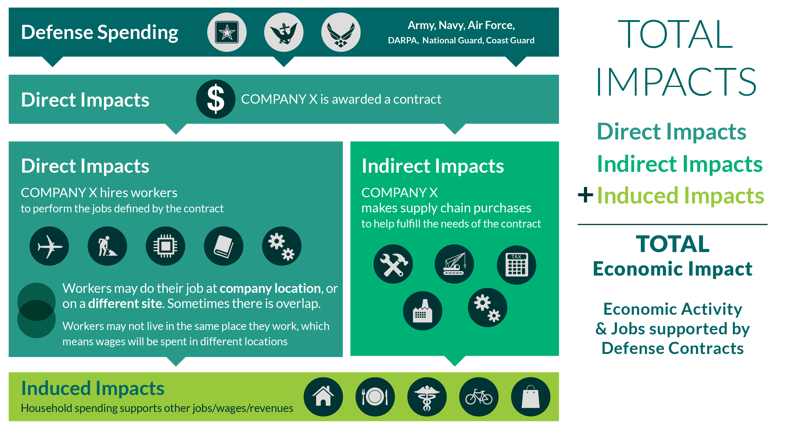
The Model

Slide 8
Data Challenges
Working with OMB Data
Adjusting fiscal year transactions data to multi-year spending.
Using 3 year average to reflect patterns in defense supplier spending.
Data cleaning
Example: all KC-46 Boeing work assigned to Seattle (King County), when actually performed in Everett, WA (Snohomish County).
Interviews
Validate or correct OMB data
Inform subsequent modeling

Slide 9
Modeling Challenges
Leveraged the Washington State Input-Output Model, but customized to reflect defense spending patterns and local, county conditions.
Converting a statewide model to county models
County-to-county interactions
Cross-county supply chains
Commuter patterns
On-site/off-site contract activity

Slide 10
Stakeholder Engagement and Input
Interviews and roundtables led to:
Deeper understanding of how defense contracts work
How benefits are distributed, even across states
Data validation

Slide 11
Defense Activities in Washington Key Findings

Slide 12
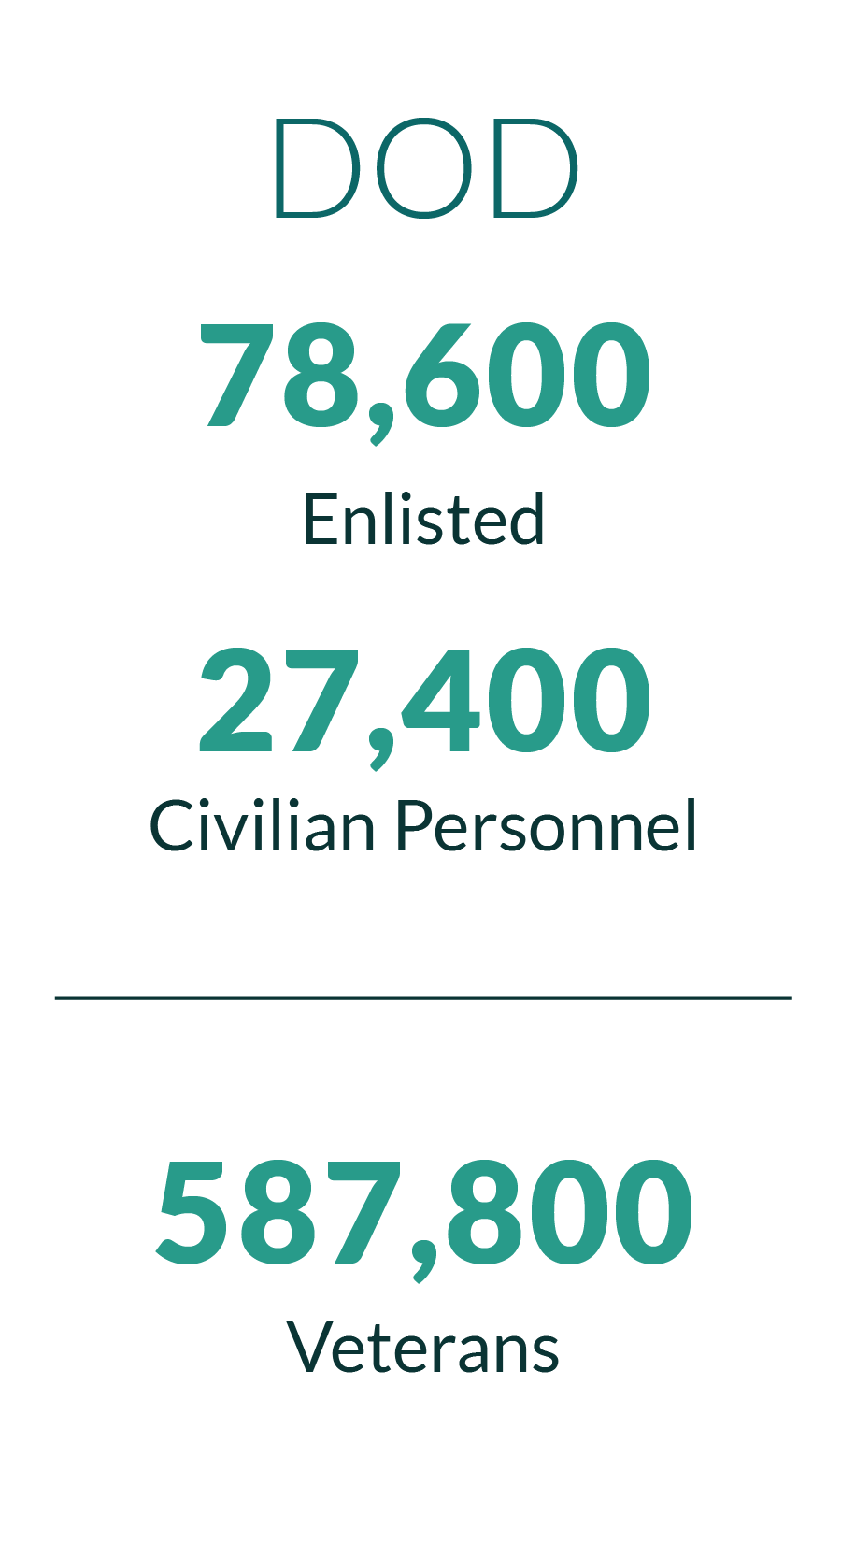
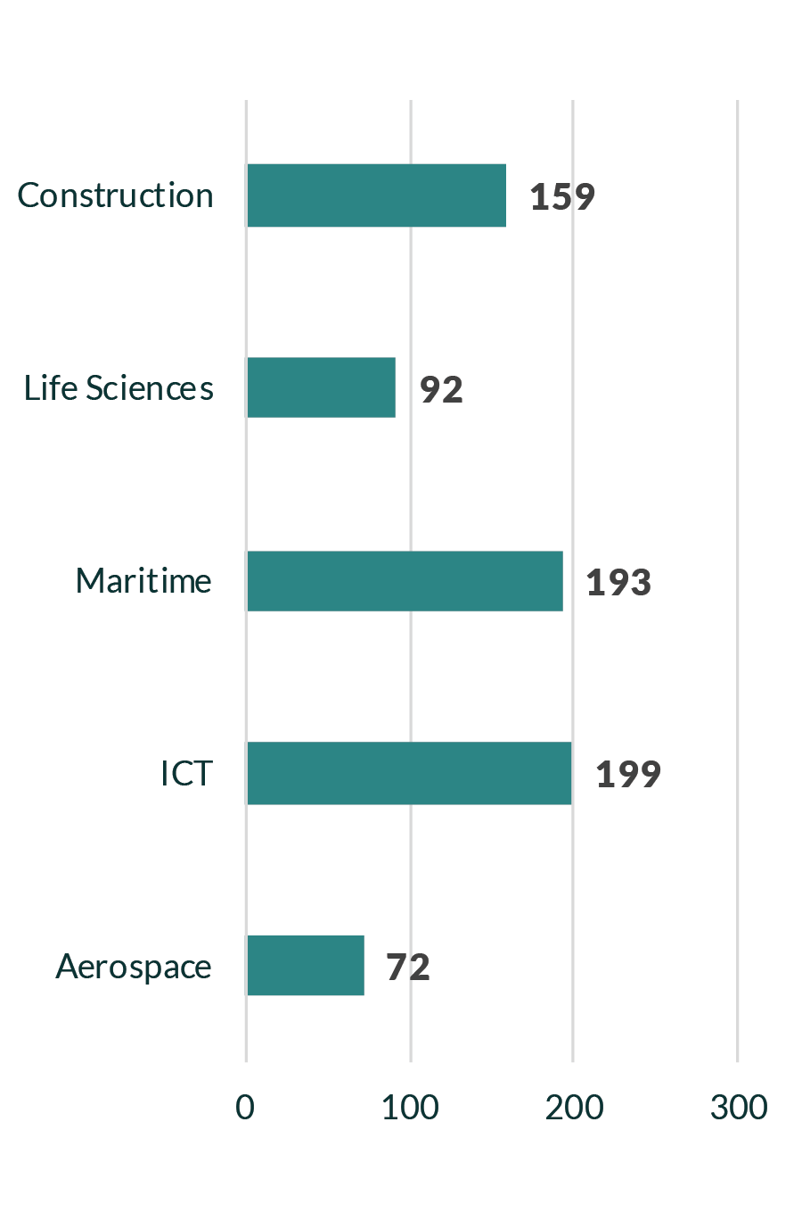
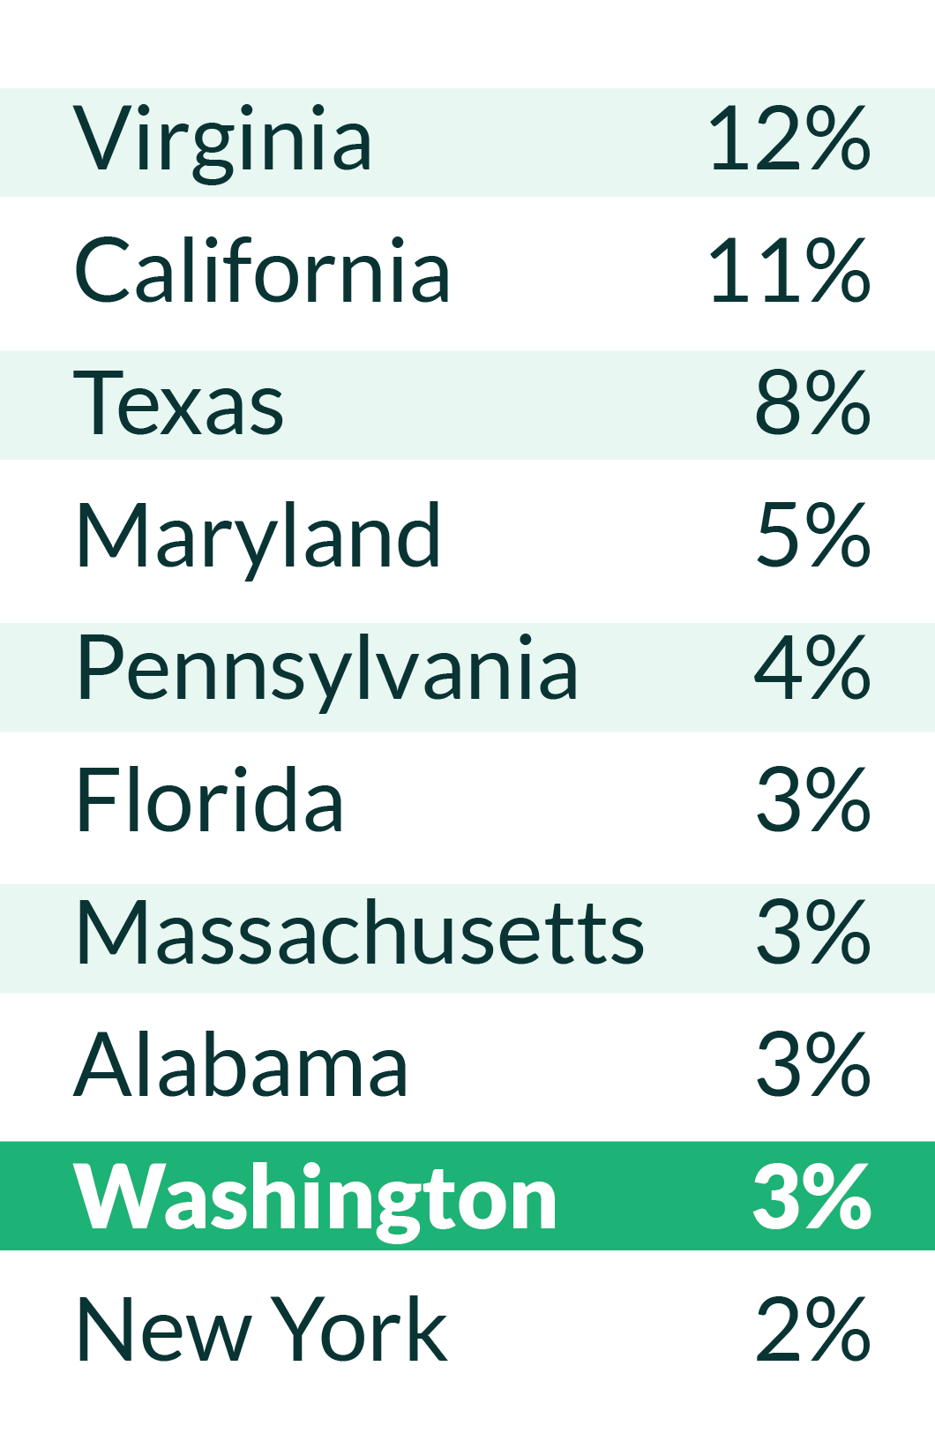
Defense Activities in Washington
WA-based Contractors by Industry, 2015
Share of total DOD contracts ($), Grants and Assistance, 2014

Slide 13
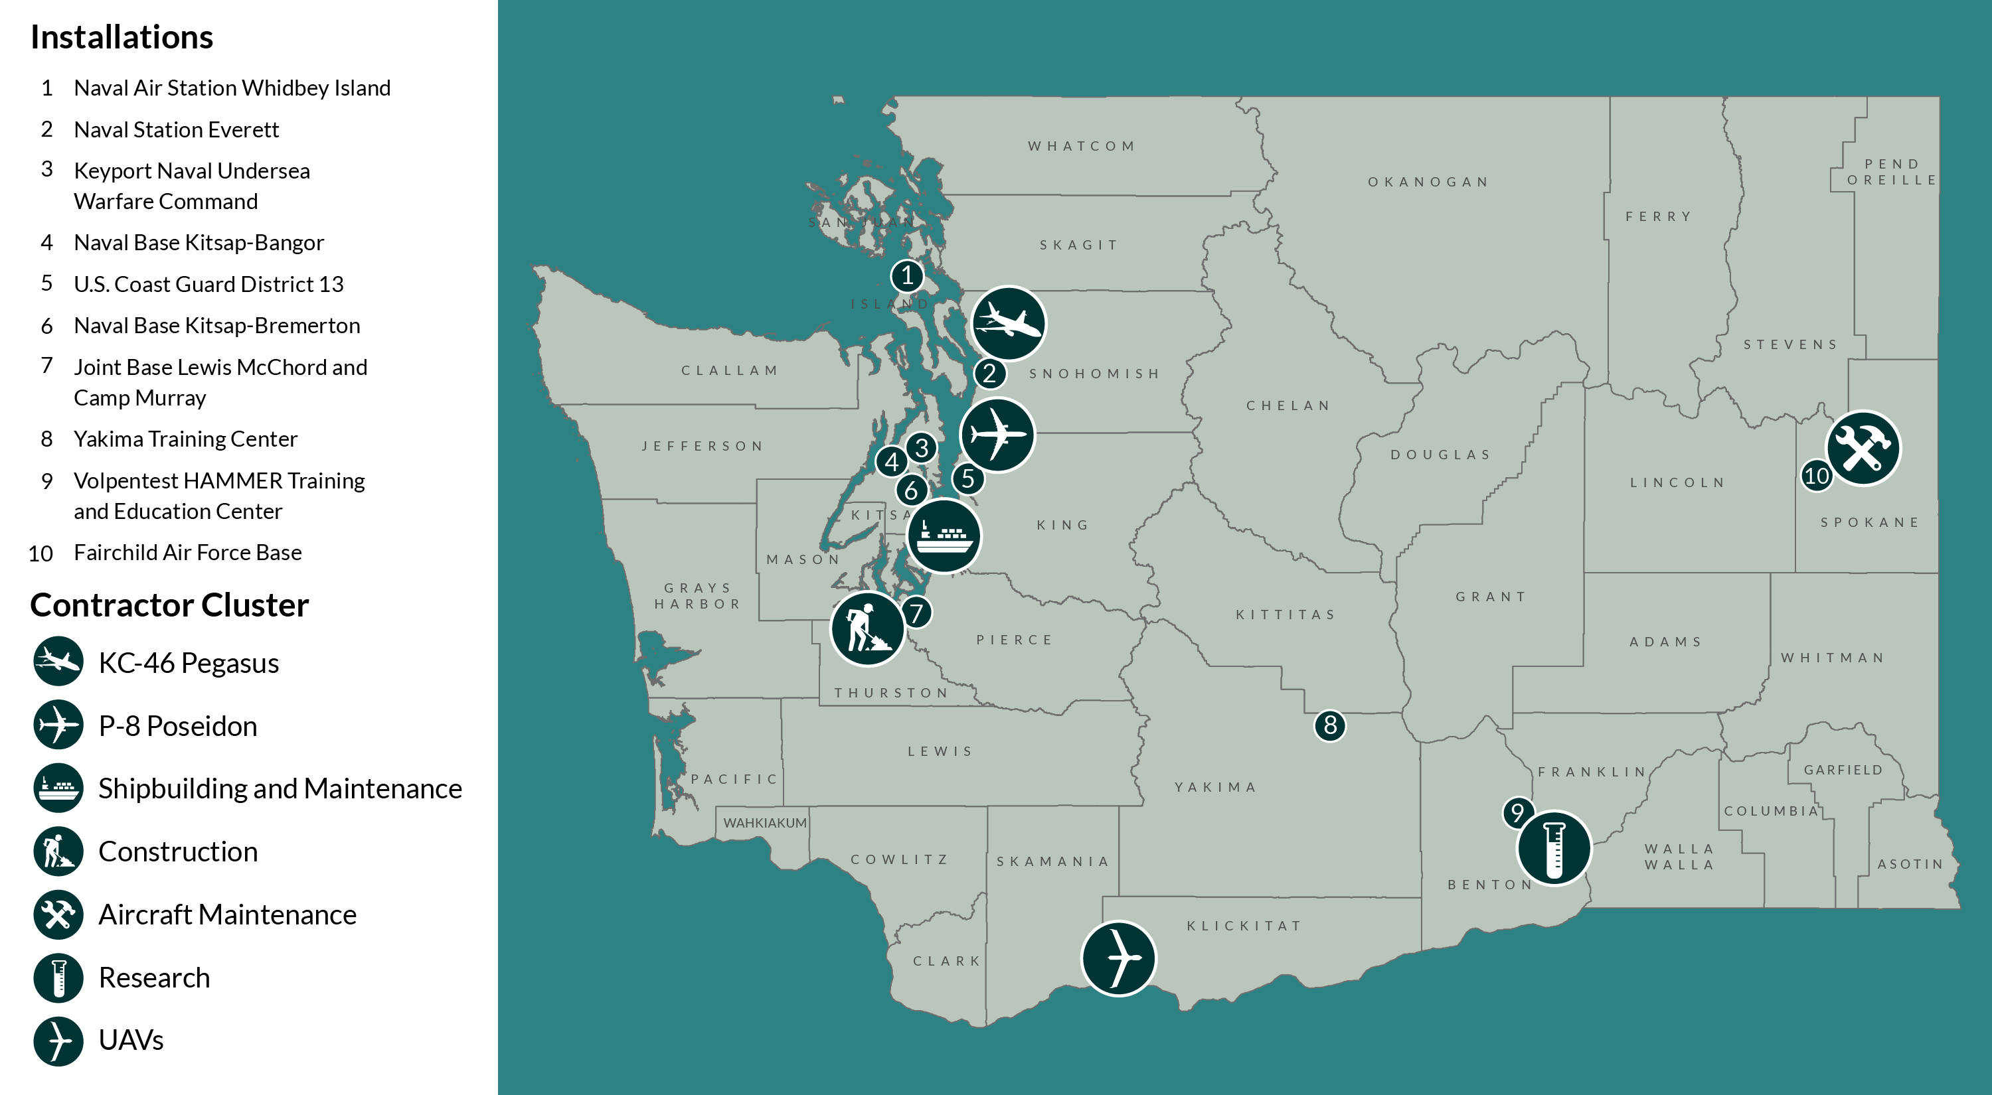
Defense in Washington State

Slide 14
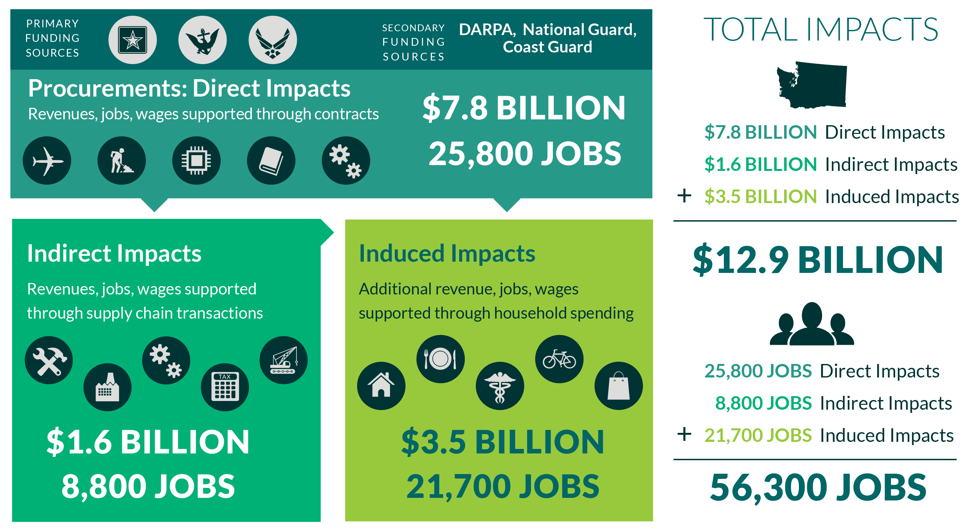
Statewide Impacts

Slide 15
Discussion

Slide 16
Discussion Questions
What worked in model?
What could be improved in existing model?
Ways to integrate ADO and stakeholder information into modeling.
New/advanced feature of the model?

Slide 17
Thank You

Slide 18
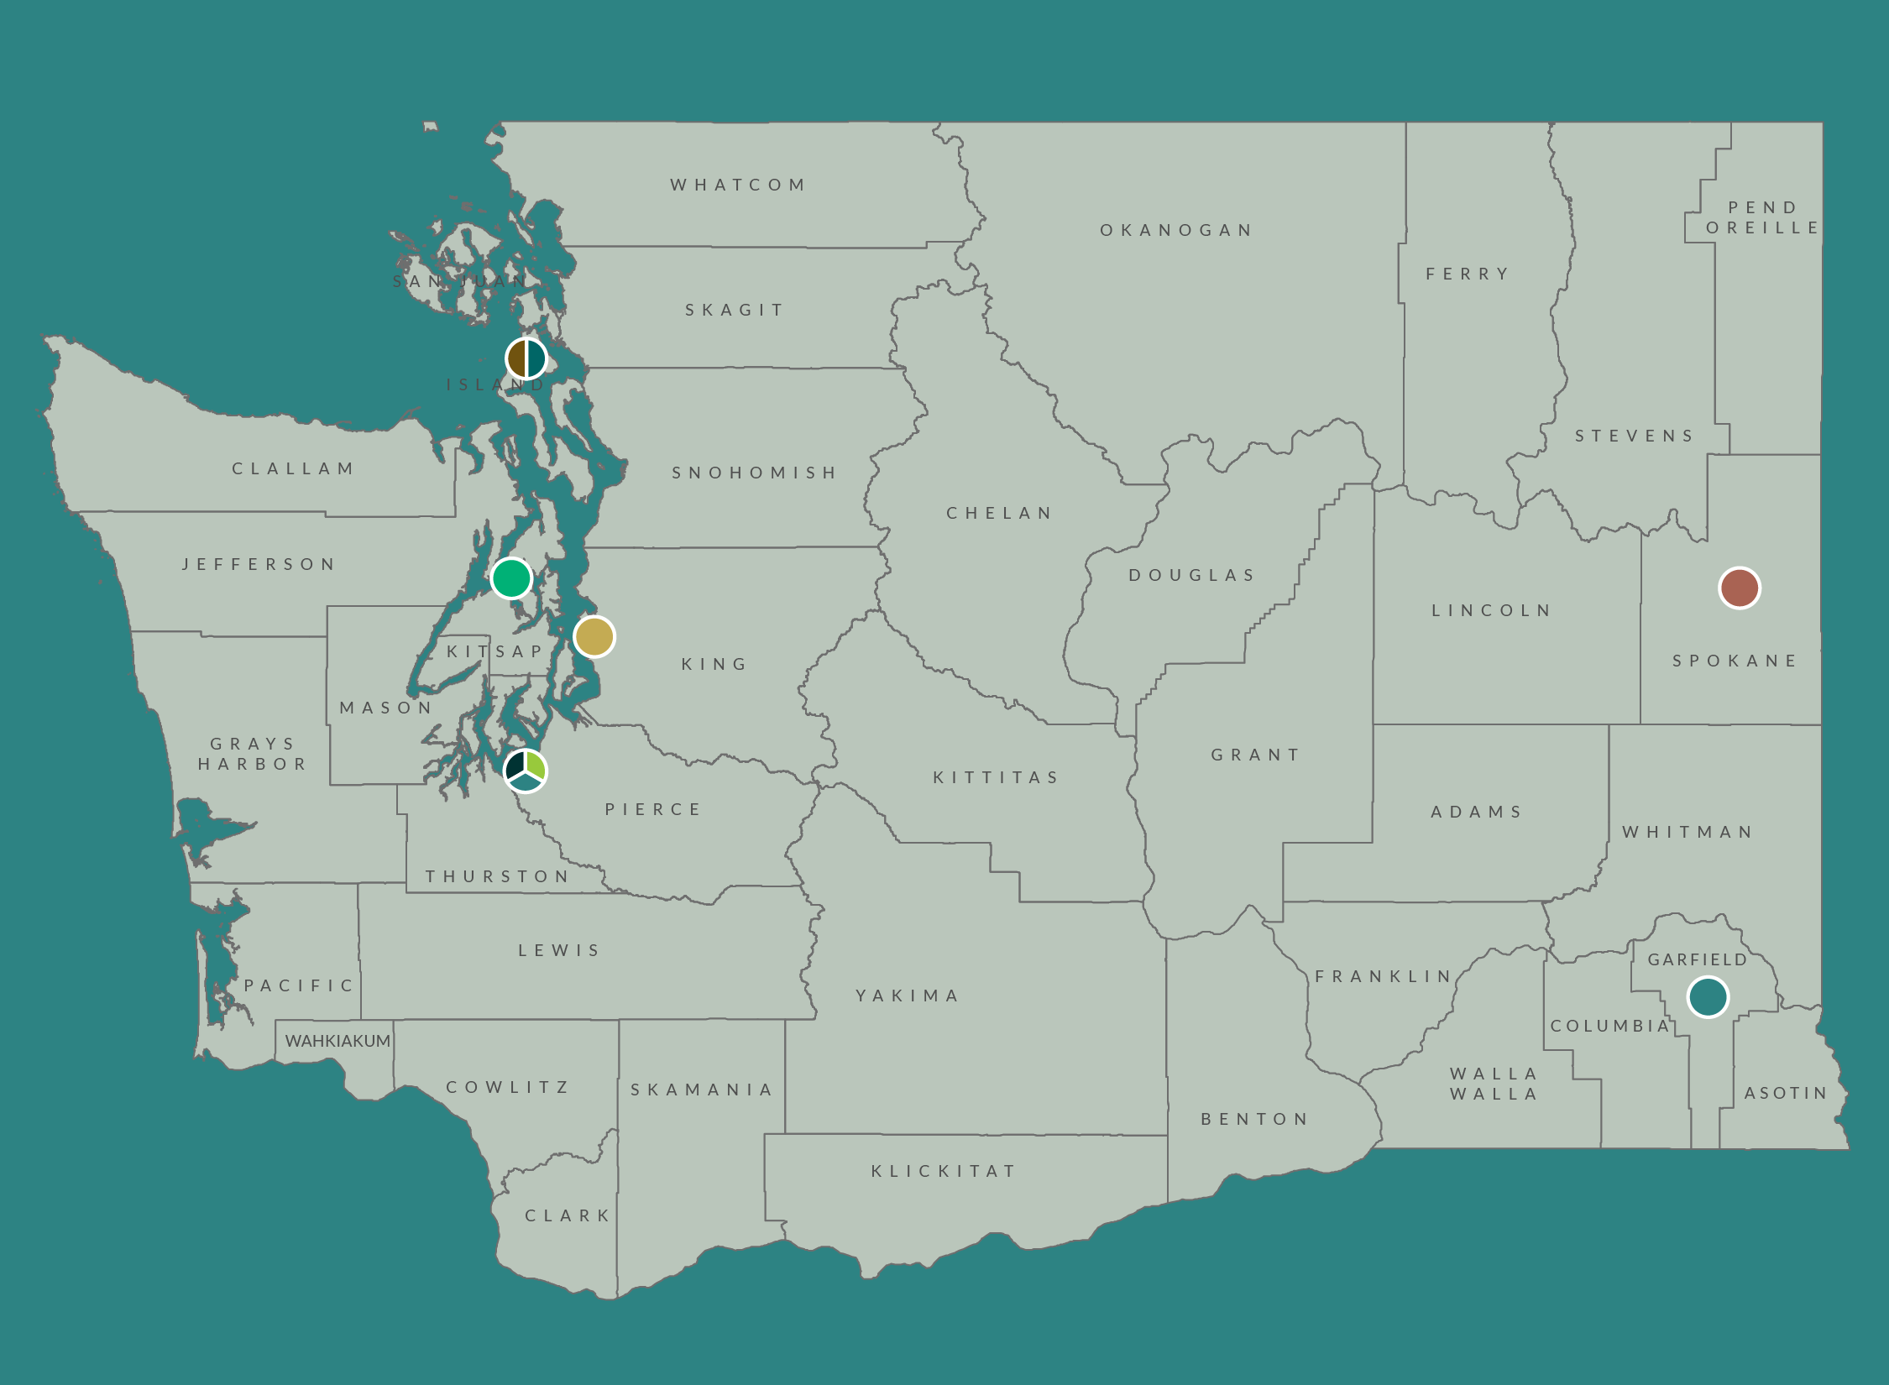
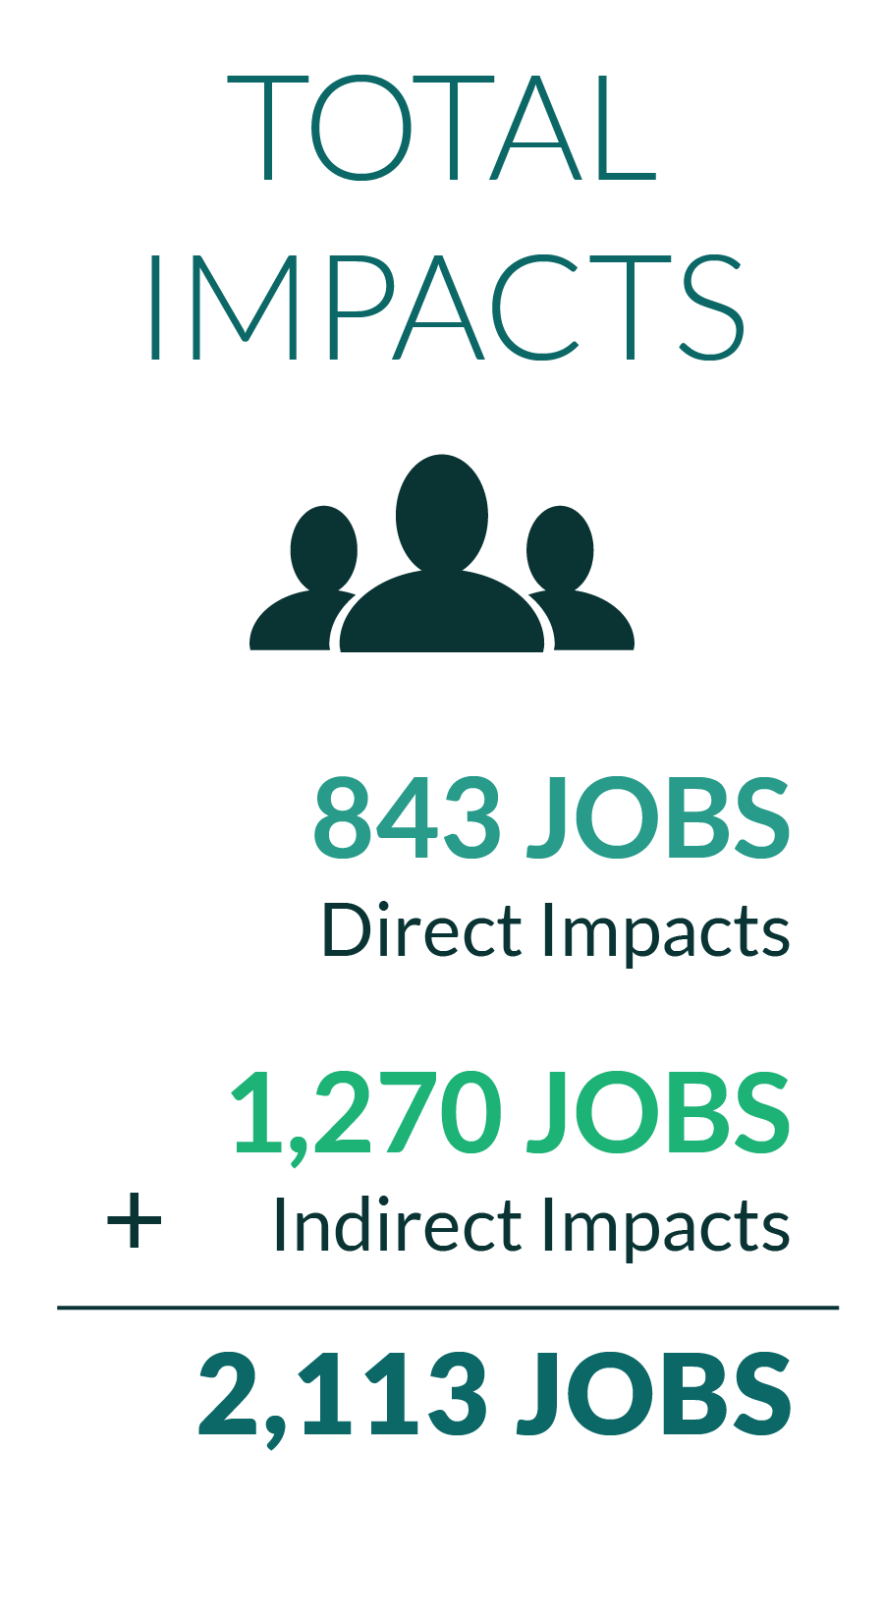
Construction Contracts

Slide 19
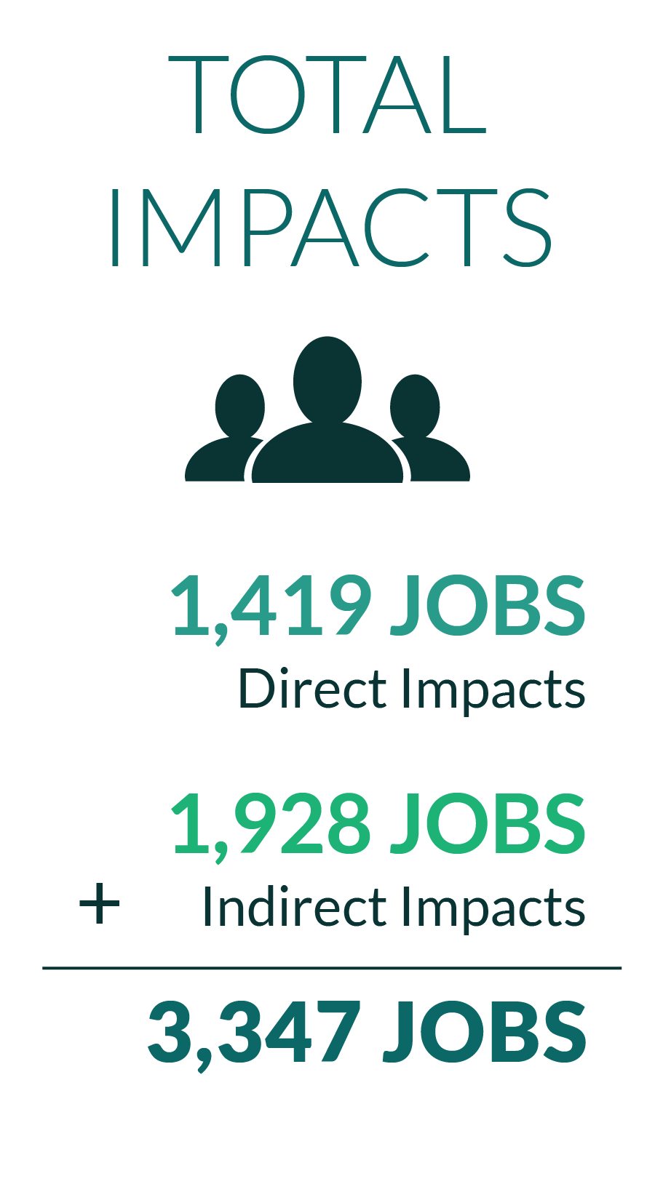
P-8 Program Impacts

Slide 20
Demo of The Modeling Tool
Use and Functionality

Slide 21
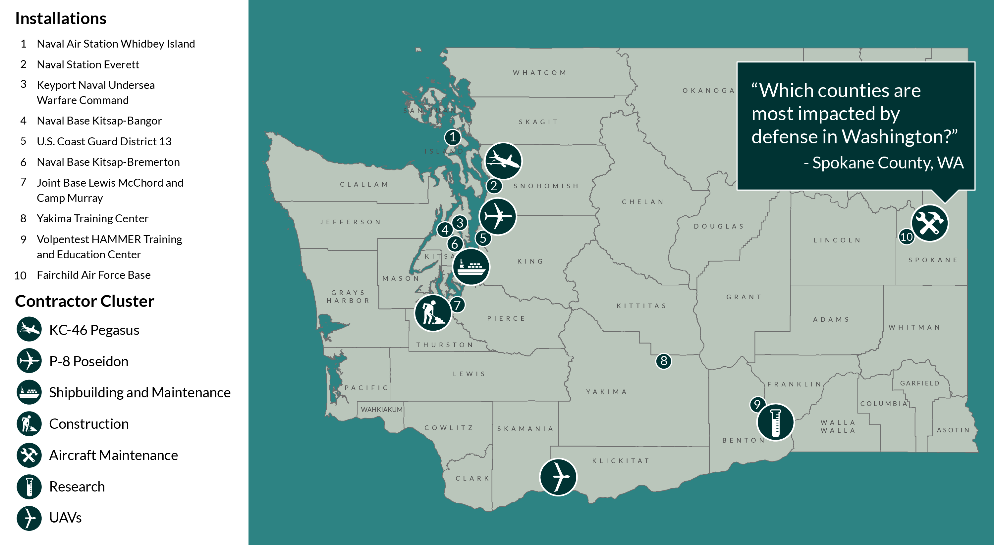
The Modeling Tool: Use and Functionality

Slide 22
Which counties are most impacted by defense in WA?

Slide 23
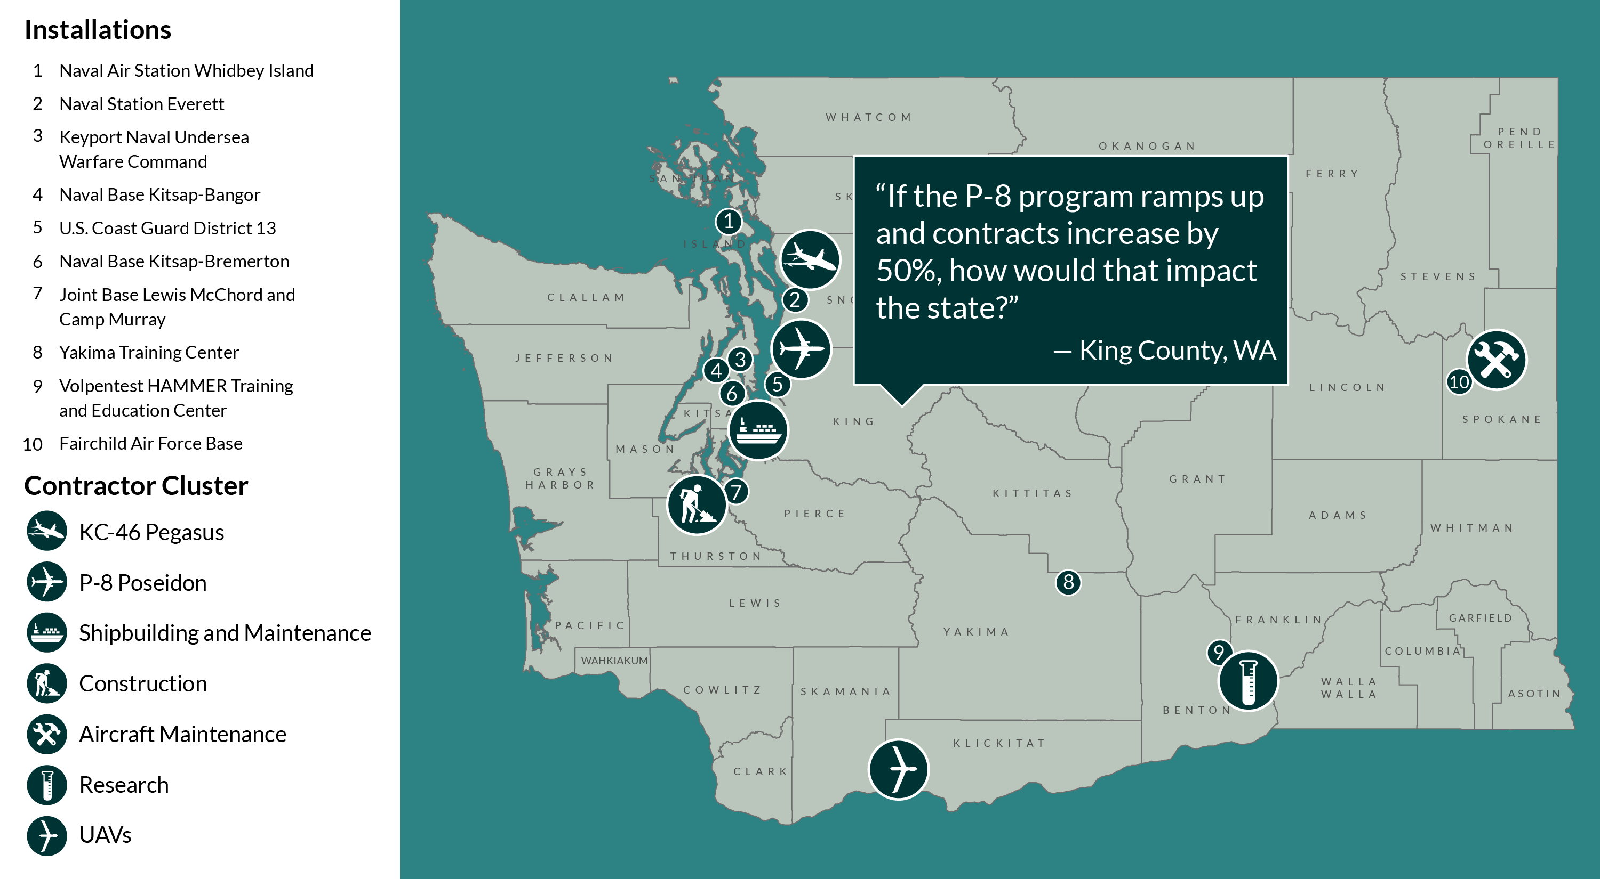
The Modeling Tool: Use and Functionality

Slide 24
How is WA impacted by 50% increase in P-8?

