Slide 1




Defense industry Adjustment and Economic Development
U.S. DoD OEA Grant Strategy and implementation for Washington state
WMA Meeting
TIP Strategies, Inc. Jeff Marcell
April 27, 2017

Slide 2

AGENDA
Strategic Plan Overview
Sustainability Strategy Overview
Expanded Defense Contract Assistance Program Overview

Slide 3
1
Strategic plan

Slide 4
Tasks of the WA OEA Grant
Assess the strengths/weaknesses of Washington’s Military and Defense Sector
Analyze capacity to respond to current and projected defense spending cuts and impacts of sequestration specific to the military and defense sector
Perform pilot studies to analyze and plan business support and workforce development specific to the military and defense sector
Promote a long-term strategic plan based on these analyses and studies in support of the military and defense sector
Ensure that the implementation is well thought out and sustainable

Slide 5
Industry adjustment analysis
& Strategy components
Organization, Communication & Stakeholder Management
Assessment & Forecasting Capacity
Analyze the State’s capacity to understand, plan for, and support implementation of a statewide response strategy to changes in defense spending
Defense Manufacturing Supply Chain Business Support Pilot
Defense Services Supply Chain Business Support Pilot
Workforce Transition Business Support Pilot
Transition Technology Tool Development Pilot
Outreach & Awareness Building via Industry
Outreach & Awareness Building via Community
Strategic Planning
Identify Growth Areas in target sectors
Develop Technology Transfer Program
Implementation Planning

Slide 6
Strategic FRAMEWORK OVERVIEW

Slide 7




strategic plan Components (1-4)
 | 1. COMMUNICATE: Raise the sector’s profile by identifying, building, and sustaining channels of communication with stakeholders and other key audiences.
 | 2. INVEST: Commit to investments that support and enhance the competitiveness of the state’s military and defense sector.
 | 3. PROTECT: Ensure the future of the state’s defense installations and unique federal facilities.
 | 4. SERVE: Connect manufacturing and services firms in the defense services supply chain with tools and support networks to enhance their economic competitiveness.

Slide 8




strategic plan Components (5-8)
 | 5. INNOVATE: Foster an environment that encourages the commercialization of defense-related technologies.
 | 6. INTEGRATE: Ensure alignment of defense industry adjustment strategies across all sector activities.
 | 7. ALIGN: Increase the alignment of talent and workforce initiatives with the needs of the military and defense sector.
 | 8. TRACK: Monitor and report on the impact and health of the sector.

Slide 9
2
Sustainability Strategy Overview

Slide 10
Sustainability Strategy
Short and long-term recommendations for transitioning the industry adjustment strategy and related activities from grant funding to a sustained and resourced strategy

Slide 11
IMPLEMENTING Organizations
Governor’s Office
Washington Department of Commerce
Washington Military Alliance
Employment Security Department
State Board Community Technical College
Procurement Technical Assistance Centers (PTAC)
Impact Washington
UW and WSU
Pacific Northwest National Laboratory
ADO’s and Business Support Groups
Installation Support Organizations
And More

Slide 12
Sustainability strategy goals
GOAL 1: STAFF RELEVANT PROGRAMS AT A SUFFICIENT LEVEL TO IMPLEMENT THE PLAYBOOK.
GOAL 2: PUT IN PLACE THE NECESSARY TOOLS AND BUSINESS PROCESSES TO SUPPORT THE PLAYBOOK.
GOAL 3: PURSUE FUNDING REQUIRED TO IMPLEMENT PLAYBOOK.
GOAL 4: WORK WITH PARTNERS TO MONITOR PROGRESS AND ADJUST THE PLAYBOOK ACCORDINGLY.

Slide 13
GOAL 1
STAFF RELEVANT PROGRAMS AT A SUFFICIENT LEVEL TO IMPLEMENT THE PLAYBOOK
Increase staffing levels at the Washington State Department of Commerce Military and Defense Sector program and the Washington Military Alliance
Make necessary leadership commitments at key state agencies and partner organizations

Slide 14
GOAL 2
PUT IN PLACE THE NECESSARY TOOLS AND BUSINESS PROCESSES TO SUPPORT THE PLAYBOOK
Put in place the tools and technologies needed to sustain the implementation process
Institute collaboration and coordination strategies to facilitate the plan’s implementation and long-range sustainability

Slide 15
GOAL 3
PURSUE FUNDING REQUIRED TO IMPLEMENT PLAYBOOK
Expand funding for critical programs
Identify funding sources to support critical projects

Slide 16
GOAL 4
WORK WITH PARTNERS TO MONITOR PROGRESS AND ADJUST THE PLAYBOOK ACCORDINGLY
Put in place clear metrics for measuring progress on plan implementation and for monitoring its effectiveness
Put in place mechanisms for tracking the health of the sector
Identify and implement specific steps for evaluating and revising the Playbook on a regular basis

Slide 17
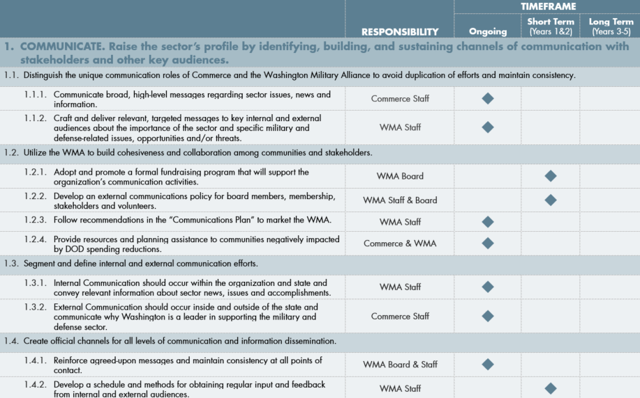
Implementation matrix

Slide 18
3
expanded defense contract assistance Program Overview

Slide 19
Project Objectives
Objectives:
Identify and assess10-20 local defense supply chain businesses to participate in the project
Develop strategies to support growth and/or diversification of potential of companies

Slide 20
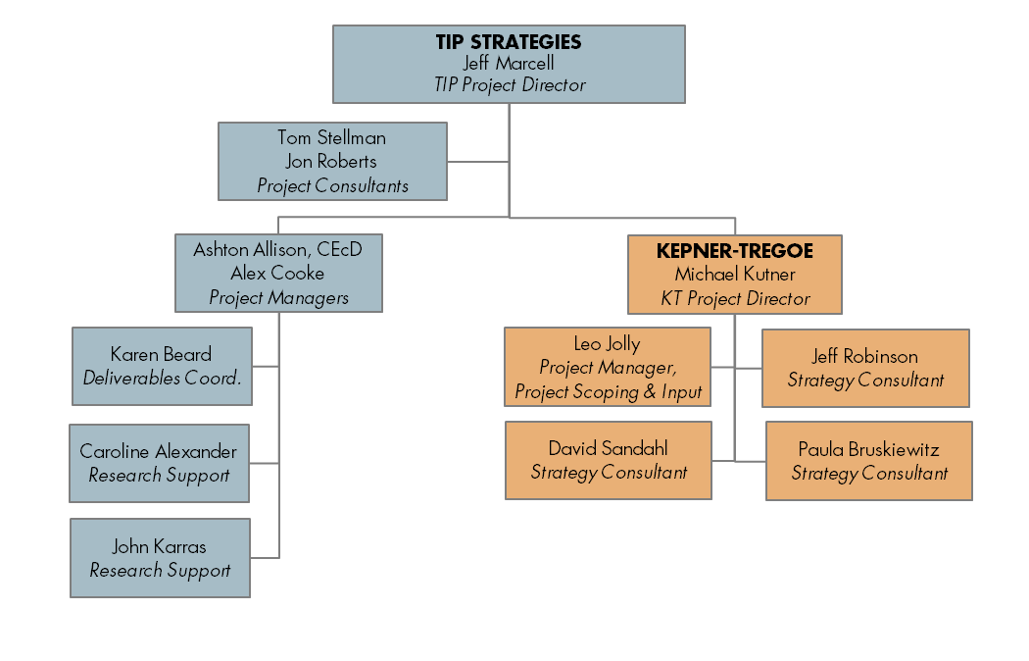
project team

Slide 21
Participant Eligibility requirements
• Firms deriving 40% or more of business revenue from a DOD contract(s) or subcontract(s)
• Demonstrated or imminent loss of at least 5% of sales and/or production due to reduced DoD expenditures
• Willingness to provide 24 months of historical sales, production and employment data
• Willingness to provide 24 months of projected sales, production and employment data
• Willingness to serve as a case study participant
• Willingness to allow the inclusion of select data (descriptive information unattributed to a specific company; no confidential disclosures) in public documents
• Willingness of senior management to participate in a 2-day executive session.

Slide 22
Consulting Services
The management consulting services paid for by the grant include:
• An assessment of each pilot company’s current strategic situation,
• An assessment of company response to the challenges of variability in DoD spending,
• Company preparedness to respond using strategic best practices,
• An action plan to move forward, with assigned responsibility
The market value of these services is $80,000 but will be provided free-of-charge.

Slide 23
Project scope of work
Step 1: Select the Participants | 1.1 Kick-off meeting 1.2 Selection criteria Defense-dependent Demonstrated impact Willingness 1.3 Candidate outreach Other grant-funded efforts Economic development and workforce partners Survey of businesses 1.4 Information session 1.5 Final selection

Slide 24
Project scope of work
Step 2: Strategy Assessment | 2.1 Organizational health assessment 2.2 Strategy assessment
Step 3: Post-Strategy Assessment Follow-up | 3.1 Action follow-up 3.2 Follow-up support (as needed)
Step 4: Case Studies | 4.1 Case studies Outline Final deliverable

Slide 25
Project Timeline
MAJOR STEPS | 2017
week beginning | APRIL |  |  |  | MAY |  |  |  |  | JUNE |  |  |  | JULY |  |  |  |  | AUGUST |  |  |  | SEPTEMBER
 | 3 | 10 | 17 | 24 | 1 | 8 | 15 | 22 | 29 | 5 | 12 | 19 | 26 | 3 | 10 | 17 | 24 | 31 | 7 | 14 | 21 | 28 | 4 | 11 | 18 | 25
1: Participants
1.1 Kickoff meeting | ◆
1.2 Selection criteria
1.3 Candidate outreach
1.4 Information session |  |  |  |  |  | ❖
1.5 Final selection |  |  |  |  |  |  |  | ⬥
2: Strategy Assessment
2.1 Organizational health
2.2 Strategic assessments |  |  |  |  |  |  |  |  |  |  |  |  |  |  |  |  |  |  |  |  | 
3: Post-Strategy Assmnt
3.1 Action follow-up |  |  |  |  |  |  |  |  |  |  |  |  |  |  |  |  |  |  |  |  |  |  |  |  | 
3.2 Additional follow-up
4: Case Studies
4.1 Outline
4.2 Deliverable |  |  |  |  |  |  |  |  |  |  |  |  |  |  |  |  |  |  |  |  |  |  |  |  |  | 
Major Milestones
◆ Project kickoff conducted  Information session conducted  Final list of participants submitted |  |  |  |  |  |  |  |  |  Company work sessions completed  Action follow-up completed  Case studies submitted

Slide 26


THANK YOU
2905 San Gabriel Street
Suite 205
Austin, TX 78705
512.343.9113
www.tipstrategies.com
Image Credit :Seattle from Dr Jose Riza Overpass by Hollywata via Flickr (CC BY-ND 2.0)

